Slide 1


Q’Leap Consulting
Draft
Strategy/Business Plan
March 22 2019

Slide 2
Contents
Introduction of TNP
Know Newark!
Market/Stakeholders Analysis
Program and Service Analysis
Human Resources
Strategic Milestones & Timelines
Q&A

Slide 3
The Newark Partnership
Economic Enhancement
Build on Newark’s distinctive assets as an inclusive and innovative community.
Stakeholders work together toward the goals of enriching the city’s prosperity and improving the QoL for all.
Nonprofit/ Community-Institution Enhancement
Civic & Community Engagement

Slide 4
The Newark Partnership
Economic development
The Newark Partnership is a city-wide nonprofit organization dedicated to promoting economic enhancement, supporting non-profit organizations and inspiring active community engagement to sustain an inclusive and innovative university city within which businesses, students, community institutions and residents can work together to improve the quality of life in Newark.
To achieve these goals, TNP focuses on three core program areas.
Establish a chamber of commerce
Support partnership programs to attract, retain and expand businesses
Partner with Delaware state and Castle chamber of commerce, and City of Newark planning development to improve economic development.
Nonprofit community
Create an information sharing network to strengthen network between nonprofit organizations and other stakeholders in the community.
Offer portal through which those who live, work & study can easily locate institutions that provide needs.
Community engagement
Active proponent for community dialogue and initiatives to improve the quality of life.
Support community partnership in arts & alliance, education, environmental sustainability, energy efficiency, multi modal transportation and diversity & inclusion.

Slide 5



Know Newark!
Newark is a town in New Castle county. Chartered in 1758, the city retains its historical features while reflecting the impacts of a University city and the influx of people and businesses. Newark is home to the University of Delaware. The University’s STAR campus has the potential to frontline incredible innovation making the city a principal technology hub for 21st economic growth. Further influencing the city is its geographic location at the tripoint of three states enhancing connectivity with urban centers across the east coast.
ECONOMY
Businesses: 850
Small Businesses: 93.1% (Delaware)
Educational Services (26.4%)
Accommodation & Food Service (11.9%)
Retail Trade (9.8%)
Healthcare and Social Assistance (9.0%)
Nonprofit organizations: 100
Employees: 14,356
Median household income: $55,525
Poverty rate: 24.8%
LIVING AND HOUSING
Median property value: $270,700
Home ownership rate: 55.9%
Average car per household: 2
Drive alone: 66.1%
PEOPLE AND DIVERSITY
Population: 32,941
Student (undergrads): 23,000
White: 75%
Asian: 8.4%
Black: 8.09%
Hispanic: 6.68%
Others: 1.65%
Median age: 24 years
Sources: DataUSA, Small Business Administration Office of Advocacy, TNP case resources

Slide 6


Market Analysis/ Partners
Leading/Core Sponsors
TNP’s partners are the various stakeholders who play critical and beneficial roles in improving the overall quality of life in the city of Newark. These Partners include:
The leading Sponsors
Businesses
Nonprofit community
Individuals
Criteria for selecting potential partners?
Based on the American Association of State Colleges & Universities (AASCU) research, we have identified criteria for partner selection.
Does partner support TNP objectives and success?
Will the partner help Newark be a great place to live in?
Will partner advance TNP’s priorities?
Will partner undermine or challenge TNP’s traditions?
City of Newark
University of Delaware
Large corporations & businesses
Students
Residents
Nonresidents working in Newark
Businesses that operates within and outside Newark
Businesses
Individuals
Non-profits
Civic Associations
Religious groups
Students Organiations
Non-profits

Slide 7
Market Analysis: Needs & Priorities
Large Organizations & Businesses
Nonprofits
Individuals/Residents
The better services, better development in the economy.
Long-tern development and sustainability
Chamber of Commerce
Informative guide for local and external organizations
Information sharing platform
Capacity building investments
Skills-based volunteering
Communications & Marketing
Program evaluation
Be part of discussions before laws are passed
Jobs/employment opportunities
Volunteering opportunities
Good quality of life
Better educational system

Slide 8
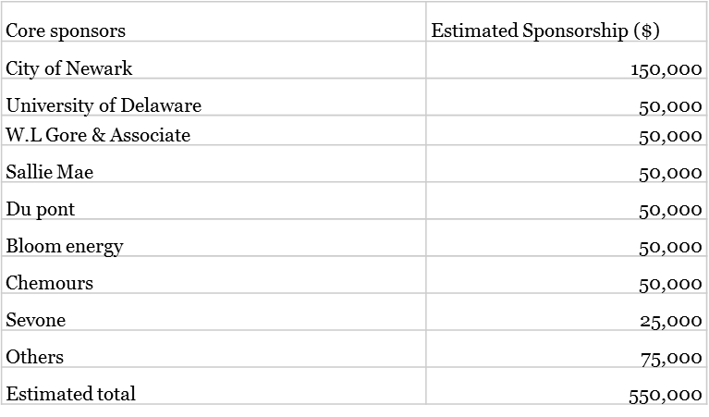
Market Analysis: Leading/Core Sponsors
Leading/Core Sponsors
These partners are the largest corporations and employers of labor in City of Newark.
As an initial part of TNP’s start up, we have estimated to raise $550,000 from these partners.
$85,000 promised by the City pending approval of events and proposals
$50,000 each for major organizations such as UD, W.L Gore and Associates with about 3000 or more employees.
$25,000 for organizations with about 500 employees.
These core sponsors are projected to be the major source of TNP’S revenue generation in the first three years. We intend to maintain these partners all through TNP’s existence. In the table to the right we present an upside showing an estimated revenue of $480,000.

Slide 9
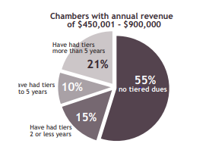
Market Analysis: Businesses
This consists of all the businesses and service firms in the City of Newark. The membership fee for businesses reflects pricing structure adopted by most chambers of commerce in the US.
According to AACE, in a 2012-13 operations survey, nearly half of 294 reporting chambers had a tiered due structure (fees according to benefits) as opposed the traditional fair share model (fees according to number of employees). However, larger chambers are most likely to use tiered structure. AACE highlights that 55% of chambers with revenue $450,000 - $900,000 use a fair share fee structure.
Given that stakeholders are focused on the benefits of their investment in today’s market, we have chosen a hybrid fee structure that reflects benefits while adopting the fair share model.

Slide 10
Market Analysis: Benefits to Businesses & Non-profits
Benefits | Businesses (Full Time Equivalent)
 | 401 + | 101- 400 | 31 - 100 | 30 or less | Non Profit
Pricing | >$5,000 | $2,500 | $1,500 | $300 | $300
Awards and recognition in publication & Newark 100 Award | × | × | × | × | ×
Discounted membership pricing at all Newark event | × | × | × | × | ×
Free catergory listing in the TNP website | × | × | × | × | ×
Free link to members social media page from TNP website | × | × | × | × | ×
Unlimited posting of company's job listing in TNP website | × | × | × | × | ×
Complementary membership to the Newark Chamber of Commerce | × | × | × | × | ×
Business referrals for TNP members | × | × | × | × | ×
Representation by the TNP at every meeting of the Newark City Council | × | × | × | × | ×
Access to TNP business facilitation unit/advising center | × | × | × | × | ×
Access to member to member program | × | × | × | × | ×
Company logo featured in TNP directory list online | × | × | ×
Complimentary drink ticket at select TNP events | × | × | ×
Limited pass to specific events like the Corporate Governance Symposium | × | × | ×
2 business articles in TNP publication | × | × | ×
Access to conference room (twice a year) at a discounted rental rate | × | × | ×
1 corporate table at annual dinner | × | × | ×
* Discount on University of Delaware graduate and certificate programs | × | ×
Priority invitation to TNP City collaborated projects | ×
Customized market research | ×
Meeting with mayor on discussion of development prospect | ×
* (subject to negotiation with associated colleges and departments).

Slide 11
Market Analysis: Non-profits & Individuals
Non-profits
Nonprofit communities consisting of advocate organizations, civil associations, religious groups etc. are a major part of the city’s engagement group. We have estimated that these stakeholders should be charged a nominal fee of $300 annually for essential networking and advocacy benefits derived from being a part of TNP. This is the average contributions and fee charged for non profits across the east coast. We have also mimicked the pricing structure of the Delaware Alliance for Nonprofit Advancement.
Individuals
Individuals can either pay a nominal fees of $50 annually or volunteer to contribute 50hours in community service. This is to enhance participation in community dialogue and community service. In a study by American Association of State Colleges and Universities, Weber State University was identified for it’s exemplary community engagement model which has been adopted by a lot of university cities. We have adopted this model as we believe it would be more powerful in engaging with more residents most of which are students.
Other fee generating resources include:
Event sponsorship
Donations
State grants.

Slide 12
Attracting Members
Present the overall goal of TNP and make the story relatable to each member
Crafting email campaign, lighthearted social media image or post.
Present benefits and satisfaction derived, knowing they are contributing to the good cause of Newark
Simplicity of Sign Up and Login – Website, Mobile Applications
Limit the amount of information required from membership application
Use online applications to facilitate and simplify the application process
Make login process easy for members with the right membership plugin
Automatic payment options
Communicate Frequently With Members (Email newsletters, Mobile notifications, Social media updates)

Slide 13
Program and Service Analysis:
Economic Enhancement
Have a dashboard, and use it to create a compelling story: Dashboard would show critical, objective metrics, update it regularly, and keep it in front of citizens, businesses, and investors. It will provide concise information about relevant factors like economic performance, well-being of the population, high school graduation rates, and where entrepreneurs are located.
Set up a business facilitation unit: A business facilitation expert assists locals to negotiate the challenges of creating a legal and potentially profitable enterprise. Teaches people on basics such as how to do a business plan, set up books and get proper permits.
Keep local business in the public eye by praising their contributions: We propose an initiative called ‘Newark 100’- Each year 100 small businesses, entrepreneurs or residents are recognized based on their contributions to the growth of Newark and awarded at a dinner reception organized in collaboration with the city of Newark. This would promote grassroot business interest.

Slide 14
Program and Service Analysis:
Non-profits Enhancement
Partner with Delaware Alliance for Nonprofit Advancement to provide support for nonprofits in Newark specifically in the areas of nonprofit training, workshop and seminars.
Establish a platform for information sharing amongst Nonprofit organization. This would be a center for event sharing
Partner with big businesses in forming an alliance with non-profits especially on skills-based volunteering

Slide 15
Civic & Community Engagement Framework
Build Foundation
Act on Goals
Design Activities
Sustain Comm Engagement
Knowledge of Community
Awareness
Customize to Culture & Circumstances
Institutionalize Comm Feedback
Understand Community Resources
Enrollment
Invest in ongoing relationships
Strong Partnerships
Education & Motivate Change
Use media & use strategically
Build culture of Comm. engagement
Empowerment

Slide 16
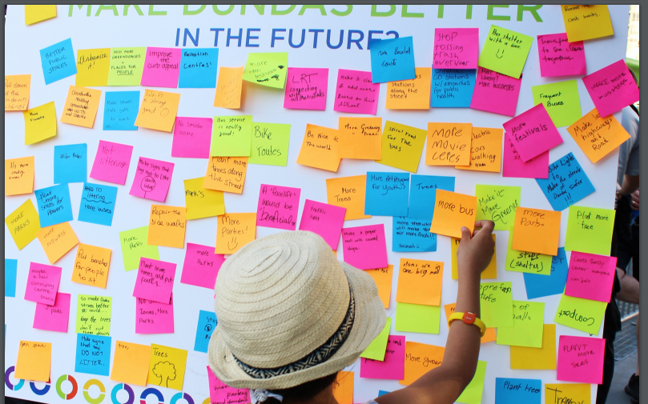
Program and Service Analysis:
Civic and Community Engagement
Street stalls to promoting community engagement and feedback at focal locations in the city including Main street, Christiana mall area, farmer’s market etc.

Slide 17
Program and Service Analysis:
Civic and Community Engagement
Web based engagement
‘Newark humans’ would be a web series portraying compelling stories of people living in Newark. This web series would incorporate learning themes designed to impact personal behaviors, raise awareness and engage the community in debate, dialogue and action around public issues. Each month, there would be free community classes focused on a wide range of topics that incorporate the learning theme.
Education
Partner with and support Nonprofit organizations who are many advocates for education to provide after school programs such as tutoring, campus visits and mentorship to inspire academic success and alert high school students of the opportunities available to them. Allocate grants to initiative that provides scholarships for program participants.

Slide 18
Program and Service Analysis:
Civic and Community Engagement
Green Carpooling
In 2016, 66% people drove alone to work in Newark, 6.5% choose carpooled and only 4.4% using public transit. 42% households in Newark have 2 cars, high car ownership in Newark increase the economic cost and resource usage.
The strategy is to inspire people to share their cars when going out. Promote a culture of shared driving is a excellent way to efficiently using energy resources and enhance the relationship between residents.

Slide 19
Program and Service Analysis:
Civic and Community Engagement
Agilent
“To Improve the human condition”
Overachieved water reduction target by 3%
To divert 95% solid waste from landfills by 2020, 3.8 million energy saving investments
JP Morgan
“Inclusive Growth”
5 year , 150 million business forward program to support underserved entrepreneurs
Bolster long term vitality of world’s cities that have not benefited from economic growth
TNP
Info Sharing
Info Sharing
Agilent Technologies, Inc
JP Morgan Chase & Co.

Slide 20
Financial Projections
 | Year 1 | Year 2 | Year 3
Revenue Composition ($)
City Grants | 85,000 | 75,000 | 75,000
Other Leading Sponsors | 400,000 | 450,000 | 450,000
Membership Dues |  |  | 205,750
Donations | 3000 | 5000 | 10,000
Other Revenues
Total | 488,000 | 530,000 | 740,750
Revenue Growth Rate |  | 8.61% | 39.76%
Expenses Composition
Director | 100,000 | 100,000 | 100,000
Program Coordinator | 65,000 | 65,000 | 65,000
Communications Support | 20,000 | 20,000 | 20,000
Administrative Support | 10,000 | 10,000 | 10,000
Benefits (Professional) | 83,435 | 83,435 | 90,000
Benefits (Non-Exempt) | 7,440 | 7,440 | 8,000
Rental For Space And Services | 50,000 | 50,000 | 50,000
Technology And Tech Support | 8,000 | 8,000 | 10,000
Printing & Supplies | 3,000 | 3,000 | 5,000
Web Development Maintenance | 20,000 | 10,000 | 13,976
Community Non-Profit Programs | 25,000 | 27,152 | 37,948
Business Programs | 40,000 | 43,443 | 60,717
Partnership With Ncc Chamber | 40,000 | 40,000 | 40,000
Community Workshop | 15,000 | 15,000 | 20,000
Total | 486,875 | 482,469 | 530,642
Profitability | 1,125 | 47,531 | 210,108
ROI | 0.23% | 9.85% | 39.60%
Assumptions:
Retention of leading sponsors in all years
Estimated 12.5% increment in leading sponsorship
Estimated membership due of $205,000 in year 3.
Business members are estimated at 20% of 850 businesses identified in Newark
Estimated 67-100% percent increase in donations
Growth in estimated costs of community non profit programs, business programs, community workshops in proportion to revenue growth

Slide 21
Value Proposition Canvas
Stakeholders/Members
TNP
Benefits:
Chamber of Commerce
Ongoing community engagement and discussions
Awards and recognitions
Skills based volunteering
Market research
Business Facilitation unit
Information sharing
Experience:
TNP is a larger grassroot organization with a record success of DNP
Wants/Needs
Fears
Good QoL
Afraid TNP is just a waste of time
Chamber of commerce
There may be more worthwhile causes out there
Volunteering opportunities
Improved Educational system
There may be more worthwhile causes out there
Features:
Econ. Enhancement
Nonprofits Enhancement
Civic & Community Engagement
Information guide/sharing
Part of ongoing discussions
There are other organizations that could serve part of these needs, however none is local to the members and TNP will also be partnering with such organizations

Slide 22
Human Resources
Board of Directors
EE Committee
Non-profit Committee
Executive Director
CC Committee
Assistance Director (Operations and Programs)
Assistance Director (Fundraising & Finance)
Assistance Director (Marketing/Social Media)
Administrative Support
&
Volunteers
Administrative Support
&
Volunteers
Administrative Support
&
Volunteers

Slide 23
Human Resources
Executive Director
Transparent and high integrity leadership
Fifteen or more years senior nonprofit management experience
Skills to collaborate with and motivate board, members and other volunteers
Planning and operation of annual budget.
Establishing employment and administrative policies and procedures for all functions and for the day-to-day operation of the nonprofit.
Serving as TNP’s primary spokesperson to the constituents, media and the general public.
Establish and maintain relationships with various organizations throughout the state and utilize those relationships to strategically enhance TNP’s Mission.
Strategic planning and implementation.
Oversee TNP Board and committee meetings.
Review and approve contracts for services
Assistant Director (Finance)
Has prior non-profit experience
Understands non-profit budget models, contracts, and regulatory requirements
Knowledgeable and passionate about TNP’s mission
Bring a strategic, high-level perspective to theTNP’s finance and accounting needs.
Build TNP’s capacity to manage its finances as it grows in size and complexity.
Partner with the ED and operations director to make decisions that benefit the organization from a financial perspective.
Solid, hands-on, budget management skills, including budget preparation, analysis, decision-making and reporting

Slide 24
Human Resources
Assistant Director (Marketing)
Have a very good understanding the community and members
Continually developing compelling messages and contents
Delivering content to the community and members
Develops (in conjunction with TNP committee members) and manages social media campaigns for events, membership, and other initiatives.
Monitors society social media channels, engages with audience, and responds to inquiries and comments.
Assistant Director (Operations)
Has prior non-profit experience
Understands non-profit budget models, contracts, and regulatory requirements
Knowledgeable and passionate about TNP’s mission
Bring a strategic, high-level perspective to theTNP’s finance and accounting needs.
Build TNP’s capacity to manage its finances as it grows in size and complexity.
Partner with the ED and operations director to make decisions that benefit the organization from a financial perspective.

Slide 25
Timelines
 | Q1 | Q2 | Q3 | Q4
Year 1 | Employ program director Create awareness in community for what TNP’ stands for and revitilazation of Newark Create a sense for culture of change | Roll out web engagement Group Nonprofits in clusters with similar needs Newsletters | Install street stalls for feedback and suggestions Initiation of design and development of information sharing platforms for nonprofits | Start the dashboard Monitor the Progress
Year 2 | Start membership in chamber of commerce Hire marketing director TNP publication | Targeted marketing Business facilitation units Internships for UD students in the area of fundraising | Engage student communities in creating mobile applications Alliance with corporations, Newark 100 Volunteering | Business research Individual surveys Monitor and verify the progress
Year 3 | Hire subject specific experts Aggressive marketing campaigns | Key performance indicators | Goals for next year | Reflect upon the membership Monitor and verify results

Slide 26
Strategic Milestones
> 6 Nonprofits and small business to be recognized by corporations located within Newark under its CSR initiatives
15% Non-profits to be partnered with DANA
Continual of grant given by Leading sponsors in year 3 of which City Council of Newark is the largest
Retaining initial members over subsequent years starting from year 2 and year 1
3
4
20% increase in volunteering and engagement from student and communities at UD in roll out of key initiatives
Addressing 70% of feedbacks provided through street stalls and other platforms
Avg. 1000 visitors per month starting from Year 1 Quarter 4
Monitor increase in web traffic growth from Year 2 Quarter 1. Web traffic growth is an important measure than web views.
1
2

Slide 27


